Slide 1

CSE- 104
Structured Programming Lab
Lab : 11 Recursion in C
Fahad Ahmed
Lecturer, Dept. of CSE
E-mail: fahadahmed@uap-bd.edu

Slide 2
Lab Performance: 10-Marks: 15-Minutes
Write a program in C to print a string in reverse using a pointer.
** don’t use any built in function
Input a string : abc de
Reverse of the string is : ed cba

Slide 3
Lab Performance: 10-Marks: 15-Minutes
Write a program in C to swap three numbers using call by reference.
Input:
The value before swapping are :
element 1 = 5
element 2 = 6
element 3 = 7
Output:
The value after swapping are :
element 1 = 7
element 2 = 5
element 3 = 6

Slide 4
Time Table
For B1:
28-03-21- Mini Test (Recursion)
bit manipulation, dynamic memory allocation
04-04-21- Lab final Viva (all topics)
11-04-21- Project (data save)+ user manual submission+ viva on project
For B2:
28-03-21- Mini Test (Recursion)
bit manipulation, dynamic memory allocation
06-04-21- Lab final Viva (all topics)
13-04-21- Project (data save)+ user manual submission+ viva on project

Slide 5

C Recursion

Slide 6
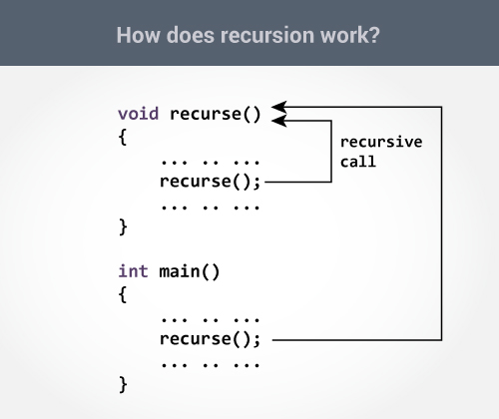
C Recursion
A function that calls itself is known as a recursive function. And, this technique is known as recursion.

Slide 7
C Recursion
A function that calls itself is known as a recursive function. And, this technique is known as recursion.
1+2+3+…..9+10 = 55

Slide 8
Sum of Natural Numbers Using Recursion
#include <stdio.h>
int sum(int num)
{
if (num!=0)
return num + sum(num-1);
else
return num;
}
int main()
{
int number, result;
printf("Enter a positive integer: ");
scanf("%d", &number);
result = sum(number);
printf("sum=%d", result);
}

Slide 9
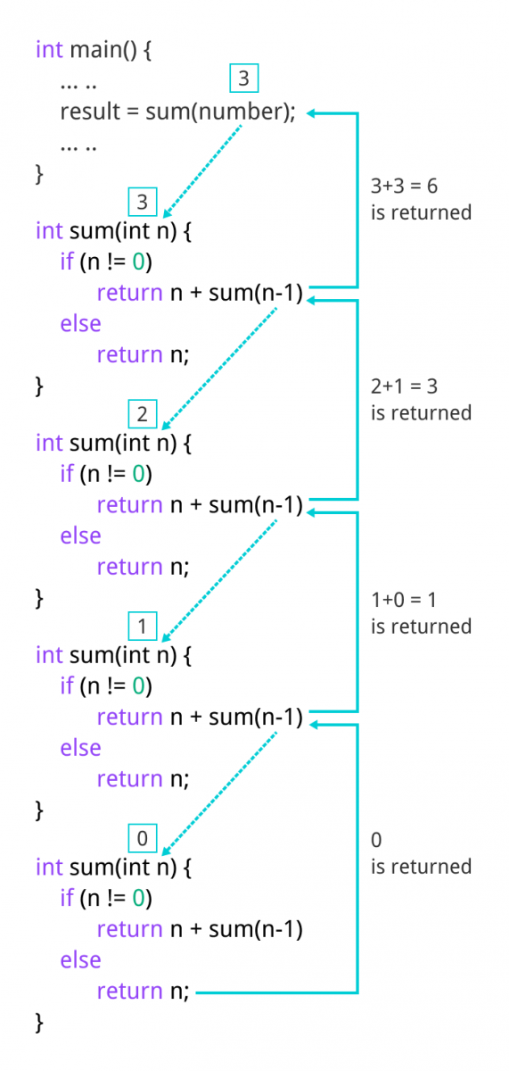
Sum of Natural Numbers Using Recursion

Slide 10
factorial
#include <stdio.h>
int factorial(int n) {
if (n == 1)
return 1;
else
return (n * factorial(n-1));
}
int main(){
int n,result;
printf("Enter the value of n: ");
scanf("%d",&n);
result = factorial(n);
printf("Factorial is : %d",result);
return 0;
}
factorial(3) = 3 * factorial(2) 3 * 2 * factorial(1) 3 * 2 * 1 = 6

Slide 11
factorial

Slide 12
Digit sum
Given a number (Max-7),
find sum of its digits using recursion.
Input : 12345
Output : 15
Input : 456320
Output :20

Slide 13
Digit sum
#include <stdio.h>
int sum_of_digit(int n)
{
if (n == 0)
return 0;
return (n % 10 + sum_of_digit(n / 10));
}
int main()
{
int num;
scanf("%d",&num);
int result = sum_of_digit(num);
printf("Sum of digits in %d is %d\n", num, result);
return 0;
}

Slide 14
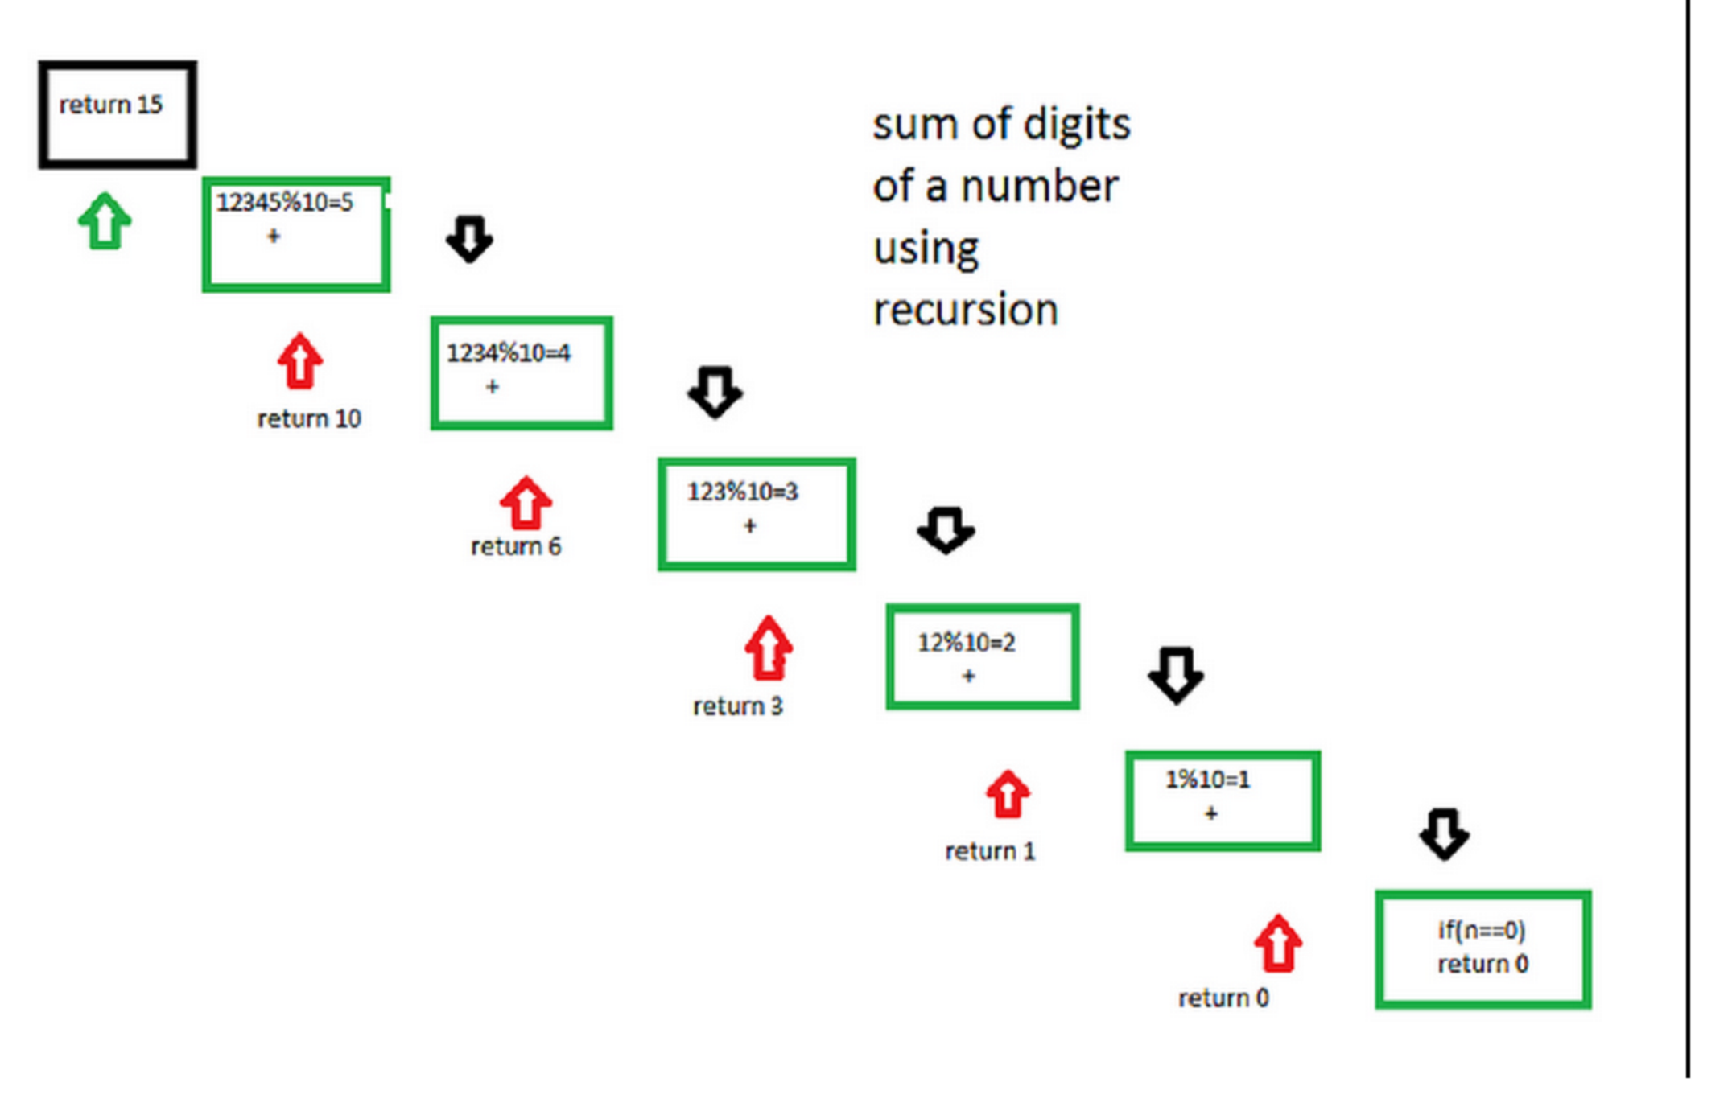
Digit sum

Slide 15
Digit sum
Let number be 12345. Step 1-> 12345 % 10 which is equal-too 5 + ( send 12345/10 to next step ) Step 2-> 1234 % 10 which is equal-too 4 + ( send 1234/10 to next step ) Step 3-> 123 % 10 which is equal-too 3 + ( send 123/10 to next step ) Step 4-> 12 % 10 which is equal-too 2 + ( send 12/10 to next step ) Step 5-> 1 % 10 which is equal-too 1 + ( send 1/10 to next step ) Step 6-> 0 algorithm stops

Slide 16
Single digit sum
#include <stdio.h>
int DigitSum(int num);
int main()
{
int n1, sum;
scanf("%d", &n1);
int s=n1;
while(s>9)
s = DigitSum(s);
printf("The Sum of digits of %d = %d\n\n", n1,s);
return 0;
}
int DigitSum(int n1)
{
if(n1 == 0)
return 0;
return ((n1 % 10) + DigitSum(n1 / 10));//calling the function DigitSum itself
}

Slide 17
Fibonacci
Program for Fibonacci numbers

Slide 18
Fibonacci
Program for Fibonacci numbers
Method 1:(Using formula) In this method we directly implement the formula for nth term in the Fibonacci series.
F_{n} = {[(√5 + 1)/2] ^ n} / √5

Slide 19
Fibonacci
Program for Fibonacci numbers
Method 1:(Using formula)
#include<stdio.h>
#include<math.h>
int fib(int n)
{
double phi = (1 + sqrt(5)) / 2;
return round(pow(phi, n) / sqrt(5));
}
int main ()
{
int n;
scanf("%d",&n);
printf("%d", fib(n));
return 0;
}

Slide 20
Fibonacci
Program for Fibonacci numbers
Method 2 ( Use recursion )
#include<stdio.h>
int fib(int n)
{
if (n <= 1)
return n;
return fib(n-1) + fib(n-2);
}
int main ()
{
int n;
scanf("%d",&n);
printf("%d", fib(n));
return 0;
}
Time Complexity:
T(n) = T(n-1) + T(n-2)
which is exponential.

Slide 21
Fibonacci
Program for Fibonacci numbers

Slide 22
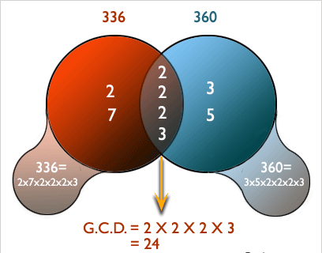
GCD

Slide 23
GCD
int findGCD(int a,int b)
{
while(a!=b)
{
if(a>b)
return findGCD(a-b,b);
else
return findGCD(a,b-a);
}
return a;
}
#include<stdio.h>
int findGCD(int num1,int num2);
int main()
{
int num1,num2,gcd;
printf(" Input 1st number: ");
scanf("%d",&num1);
printf(" Input 2nd number: ");
scanf("%d",&num2);
gcd = findGCD(num1,num2);
printf("\n The GCD of %d and %d is: %d\n\n",num1,num2,gcd);
return 0;
}

Slide 24
C Recursion
What is tail recursion?
A recursive function is tail recursive when recursive call is the last thing executed by the function. For example the following C++ function print() is tail recursive.
void print(int n)
{
if (n < 0) return;
cout << " " << n;
// The last executed statement is recursive call
print(n-1);
}

Slide 25
Lab performance solution
#include <stdio.h>
int main()
{
char str1[50];
char revstr[50];
char *stptr = str1;
char *rvptr = revstr;
int i=-1;
printf(" Input a string : ");
gets(str1);
while(*stptr)
{
stptr++;
i++;
}
while(i>=0)
{
stptr--;
*rvptr = *stptr;
rvptr++;
--i;
}
*rvptr='\0';
printf(" Reverse of the string is : %s\n\n",revstr);
return 0;
}

Slide 26
Lab performance solution
#include <stdio.h>
void swapNumbers(int *x,int *y,int *z)
{
int tmp;
tmp=*y;
*y=*x;
*x=*z;
*z=tmp;
}
int main()
{
int e1,e2,e3;
printf(" Input three elements : ");
scanf("%d%d%d",&e1,&e2,&e3);
printf("\n The value before swapping are :\n");
printf(" element 1 = %d\n element 2 = %d\n element 3 = %d\n",e1,e2,e3);
swapNumbers(&e1,&e2,&e3);
printf("\n The value after swapping are :\n");
printf(" element 1 = %d\n element 2 = %d\n element 3 = %d\n\n",e1,e2,e3);
return 0;
}

Slide 27

Thanks to All

